Slide 2
MOBILIZING FOR IMPACT
How The Legal, Charitable, Public and Private Sectors Joined Forces in the Fight Against Sex Trafficking
Panelist: John Montgomery, Of Counsel, ROPES & GRAY LLP
Panelist: Audrey Morrissey, Associate Director, MY LIFE, MY CHOICE
Panelist: Ziba Cranmer, Executive Director, DEMAND ABOLITION
Panelist: Phillip Martin, Senior Investigative Reporter, WGBH

Slide 3
What you should know about human trafficking
An estimated 30 million individuals are trafficked worldwide
The majority of girls sold for sex are 12 to 14 years of age
An estimated 244,000 - 293,000 children are at risk in the U.S.
40% to 70% of street youth engage in occasional illegal commercial sex
Debt and poverty are the chains binding many trafficking victims
There is a thin line between smugglers of human beings and traffickers in human beings
Female Sex Trafficking is heavily racialized
Victims in the US are disproportionately Black, Asian & Latina
African Americans under the age of 18 comprise 52.3% of total arrests for illegal commercial sex

Slide 4
What you should know about human trafficking (continued)
Many victims come from the foster care system
In Florida, 70% are estimated to be foster youth
In New York, 85% had prior child welfare involvement
Sex trafficking in the US is associated with
Bars/Club operations, residential brothels, escort services, etc. other locations
Increasingly, the sale of illegal commercial sex has migrated to the internet
Backpage.com is the dominant website, carrying more than 80% of the advertisements and other communications

Slide 5
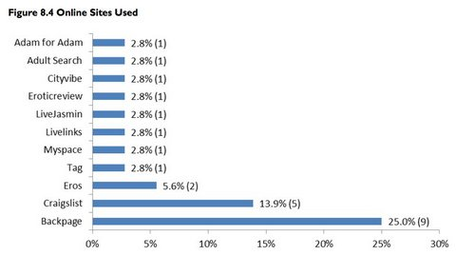
The Business of Sex Trafficking
Human trafficking is a $32 billion, labor-intensive criminal industry
Second behind drug dealing; tied with illegal arms
Pimps can make anywhere between $5,000- $32,000 per week
The internet has increased the “efficiency” and thus the frequency of illegal commercial sex

Slide 6
Controversy Over Legalizing the Sex Trade
Abolitionists believe all commercial sex is coerced, forced or involuntary
Sex worker advocates believe that some individuals choose the sex trade of their own accord
Language matters: Huge difference between “being a prostitute” and someone who “is prostituted”
Terms like “pimps” and “hos” degrade women but have been sanctioned by society

Slide 7
Boston has become a leader in the fight against sex trafficking by mobilizing a coalition of advocates in the legal, charitable, public and private sectors. The community’s efforts have become a model for other cities and for other equally worthy social causes. Join us.

Slide 8
My Life My Choice

Slide 9
