Slide 2
Panelists
Deborah Bing, President and Principal, CFAR
Jason Born, Vice President for Programs, National Center for Family Philanthropy
Lynne Doblin, Executive Director, Richard and Susan Smith Family Foundation
Jean Whitney, Philanthropic Advisor, Ropes & Gray LLP
Copyright © 2016 National Center for Family Philanthropy

Slide 3
National Center for Family Philanthropy: 2015 Trends Study
First nationally representative sample of all family foundations
A benchmark report — NCFP expects to produce this study every 3-4 years
Provides greater awareness and informed discussions about family philanthropy trends
Full report: www.ncfp.org
Copyright © 2016 National Center for Family Philanthropy

Slide 4
42,300: U.S. family foundations in 2013
44 percent: Increase in number of family foundations, 2002-13
$23.9 billion: Total giving by U.S. family foundations in 2013
93 percent: Increase in giving by U.S. family foundations, 2002-13
Copyright © 2016 National Center for Family Philanthropy

Slide 5
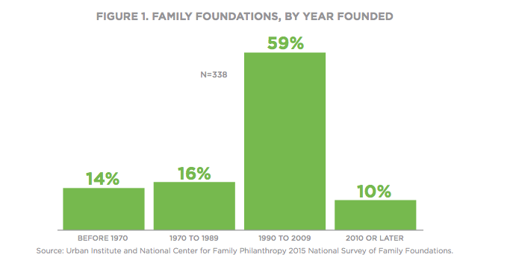
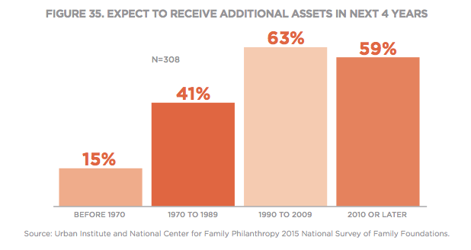
Nearly 70% of family foundations created since 1990
More than 60% of family foundations created since 1990 expect to receive additional assets within next 4 years
Copyright © 2016 National Center for Family Philanthropy

Slide 6
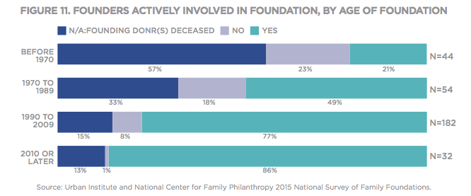
Copyright © 2016 National Center for Family Philanthropy

Slide 7
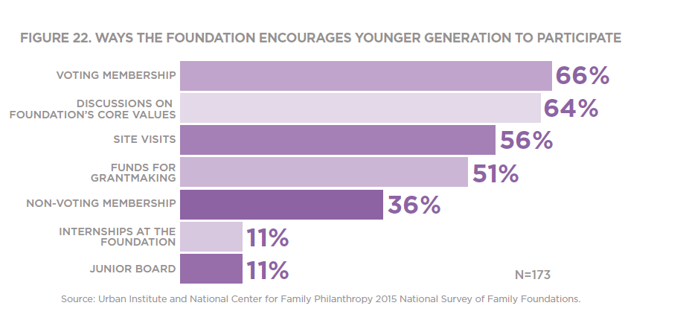
Copyright © 2016 National Center for Family Philanthropy

Slide 8
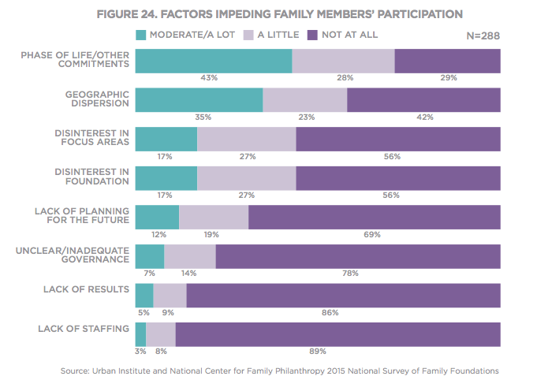
Copyright © 2016 National Center for Family Philanthropy

Slide 9
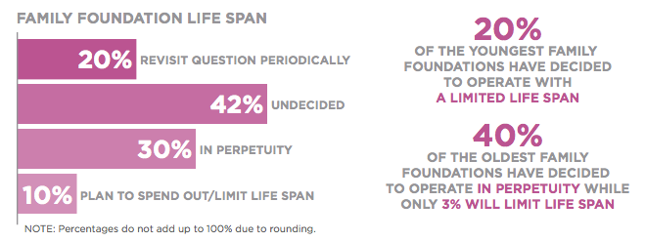
Copyright © 2016 National Center for Family Philanthropy

Slide 10
Which findings resonate most strongly with you and are of most relevance to your work?
Which trends are of most interest to you?
Copyright © 2016 National Center for Family Philanthropy

Slide 11
Additional questions? Let us know!
Deborah Bing, President and Principal, CFAR, 617.576.1166, Dbing@cfar.com
Jason Born, Vice President for Programs, National Center for Family Philanthropy, 202.350.9376, jason@ncfp.org
Lynne Doblin, Executive Director, Richard and Susan Smith Family Foundation, 857-404-0700, ldoblin@smithfamilyfoundation.net
Jean Whitney, Philanthropic Advisor, Ropes & Gray LLP, 617.235.4812, Jean.Whitney@ropesgray.com
Copyright © 2016 National Center for Family Philanthropy

