Slide 1



Slide 2

FII working definition of social capital:
Services and goods exchanged between families without exchanging dollars, which would otherwise have some economic value.
These include things like providing childcare or transportation for someone else. 70% of Boston families have engaged in some form of social capital exchange.

Slide 3
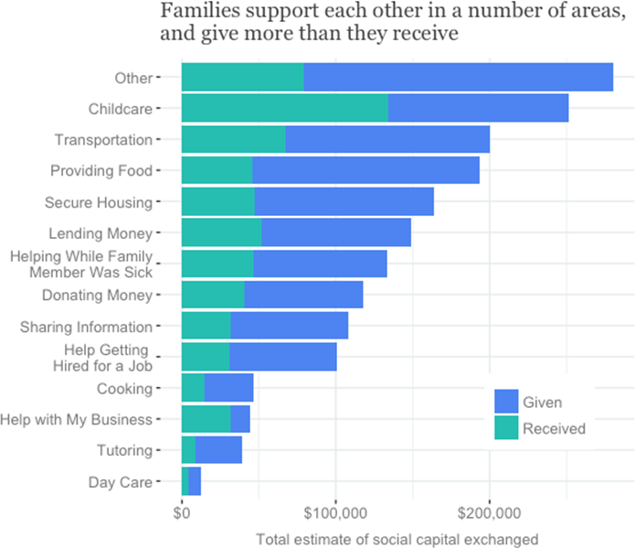

Slide 4
Families in Greater Boston have exchanged an estimated $1,915,983 worth of goods and services, with:
$1,241,654 given
$674,329 received
$2,161 = average exchanged per family
$1,414 = average amount families have given
$747 average amount families have received
Notes:
Families in the Boston area have exchanged an estimated $1,915,983 worth of goods and services, with
$1,241,654 given, and
$674,329 received. These exchanges come out to an average of
$2,161 per family. On net families give more than they receive with families giving an estimated
$1,414 worth of social capital while receiving about $747 back.

Slide 5
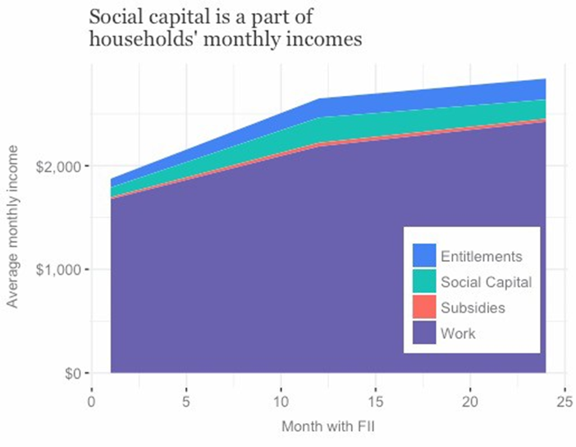
Notes:
looking only at support that families received, we can see that these informal exchanges make up a meaningful portion of families’ economic profiles. On average, social capital is contributing about 5% to 10% of a household’s monthly income.

Slide 6
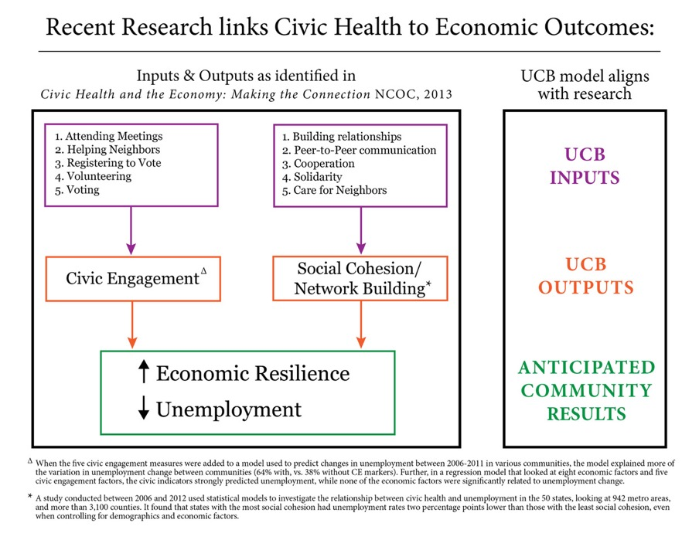

Slide 7

