Slide 1
An Intergenerational Conversation about Power and Privilege

Slide 2
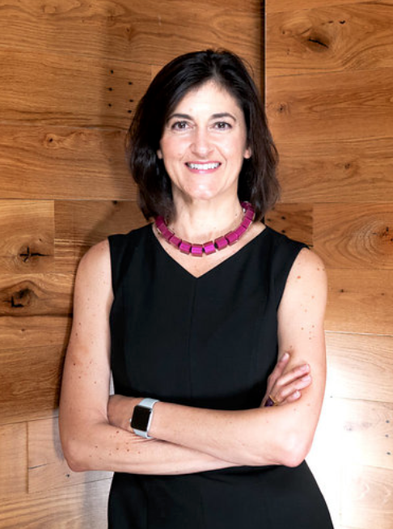
Kelly Nowlin
5th Generation Trustee, Surdna Foundation
Chair of Andrus Family Program
Founding Board Member of the Andrus Family Fund – 5th Generation Fund created by 4th Generation
Practicing Consultant in Family Philanthropy
Surdna est. 1917 by Great Great Grandfather

Slide 3
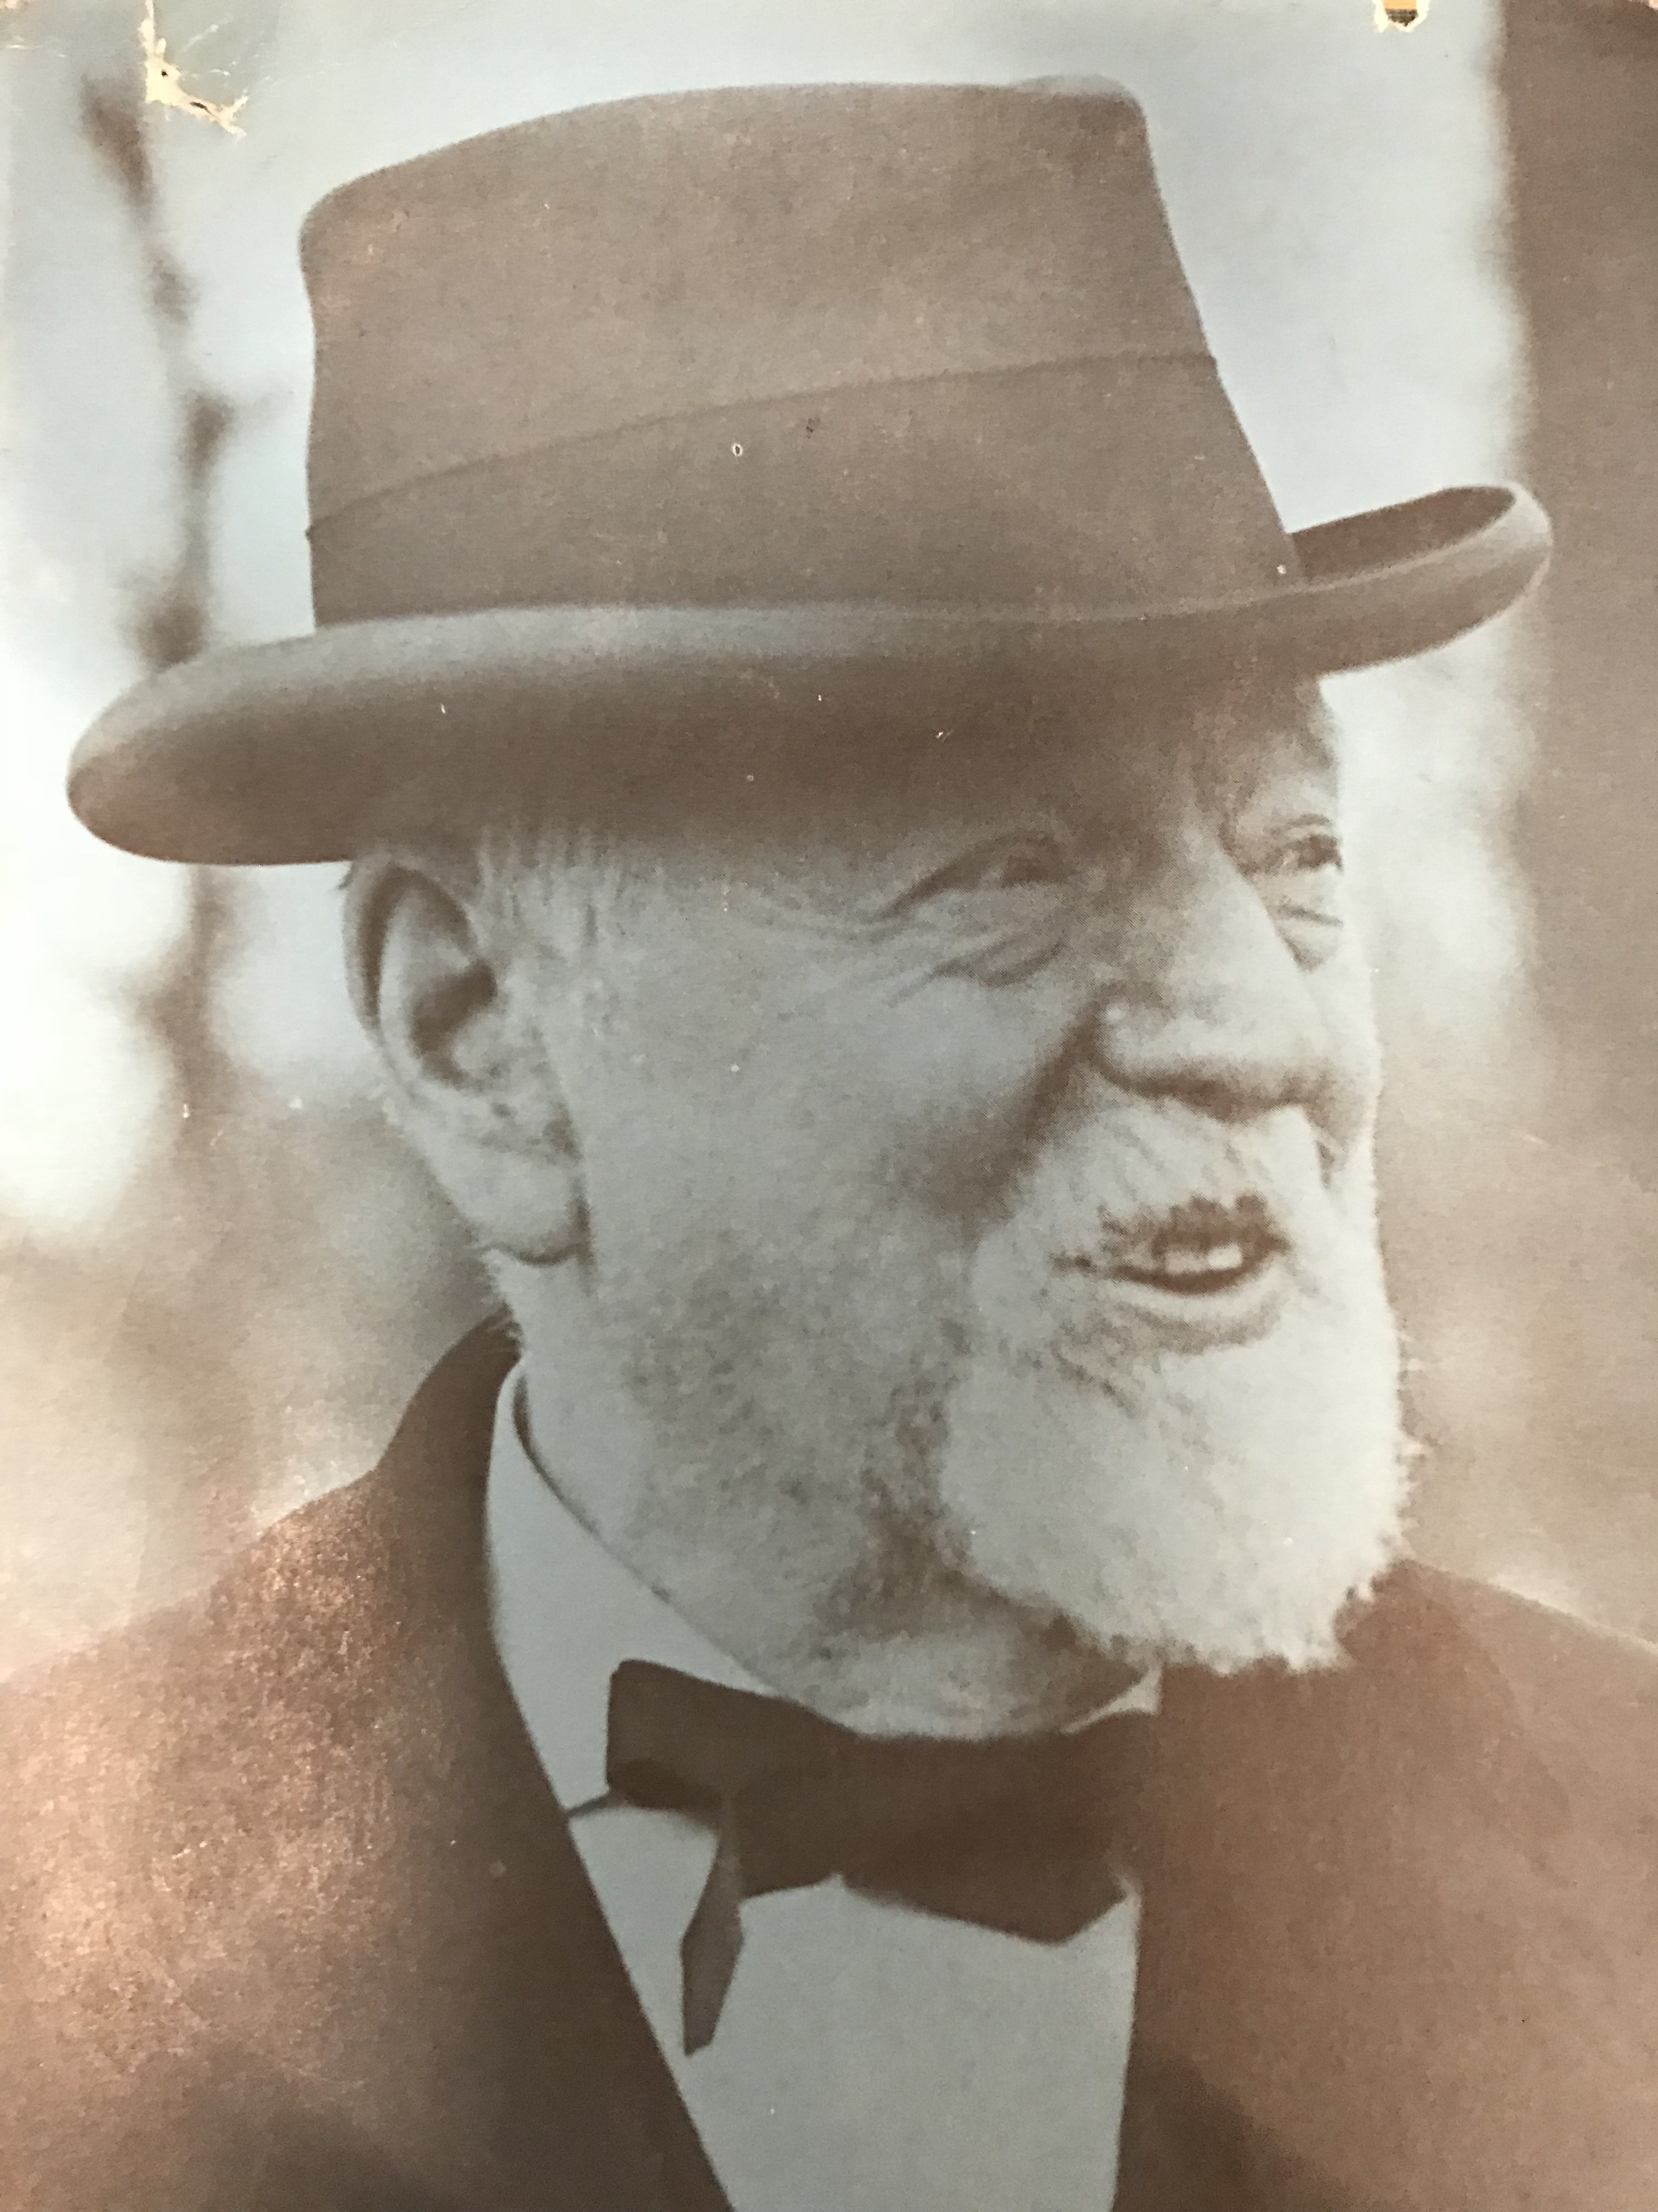
John Emory Andrus
Farmer
Lamplighter
Educator
Chemist
Mayor
Congressman
Philanthropist
“The Multi-Millionaire Straphanger”

Slide 4
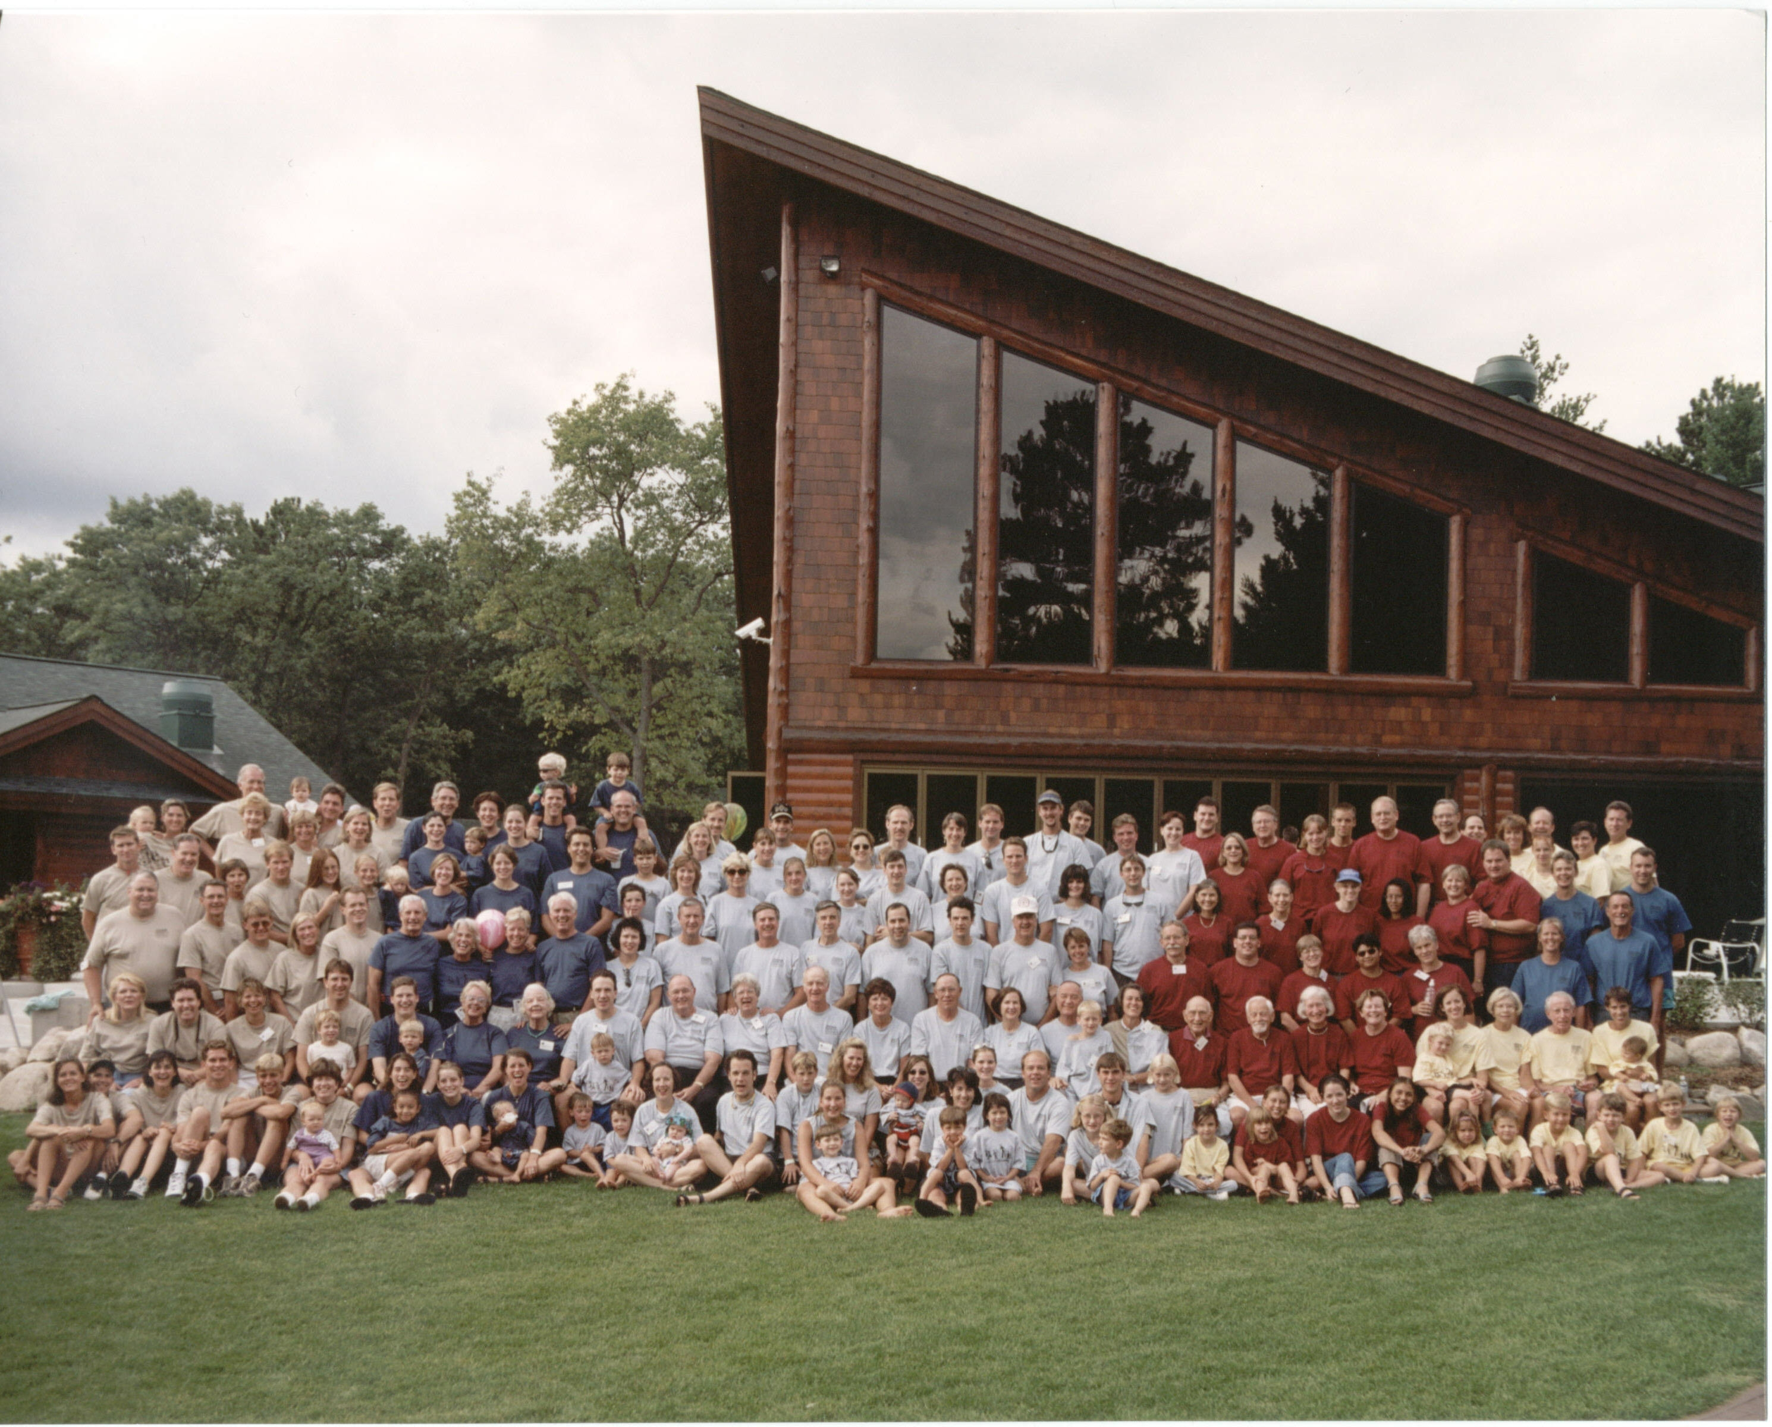
The Andrus Family
Nearly 500 living Andrus family members
8 Family branches

Slide 5
The Andrus Family Philanthropies
Andrus Youth Service Program
“AYSP”
Board Experiential Training
“BETS”

Slide 6
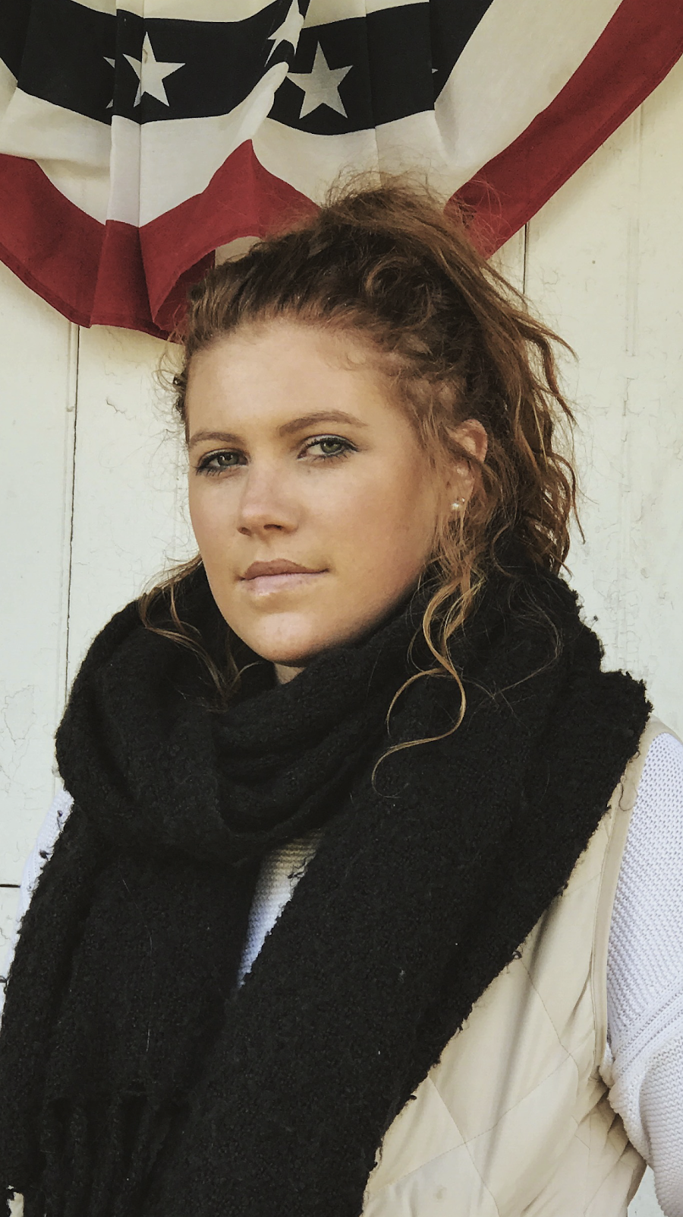
Ali Pakradooni
6th Generation Andrus Family Member
Graduate of the Andrus Youth Service Program
Completed two rounds of Board Executive Training (BETs)
Fellow for Frieda C. Fox family Foundation
Student studying Kinesiology at Temple University
Notes:
Ali, can you add your bullets and headshot to this slide?

Slide 7
Andrus Youth Service Program

Slide 8
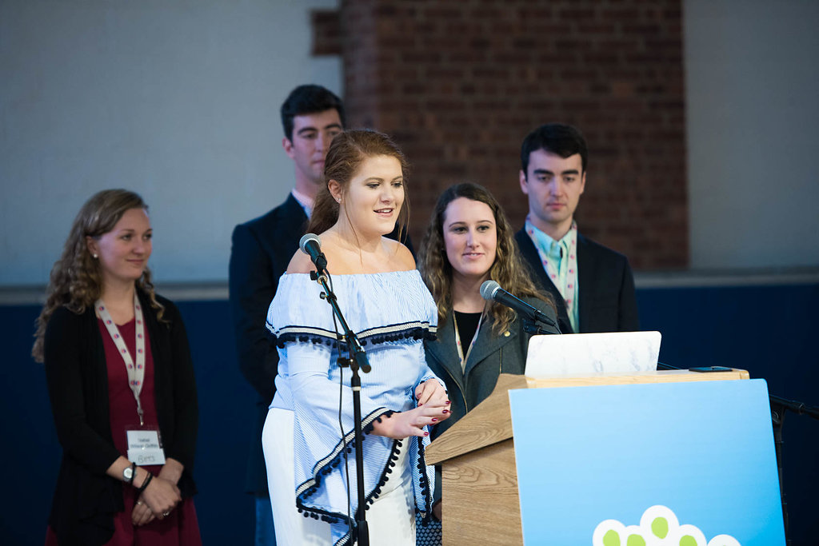
Board Experiential Training Program
B
E
T
S
Notes:
Waiting to get access to other photos from centennial to include one of you instead of this one.

Slide 9
got privilege?

Slide 10
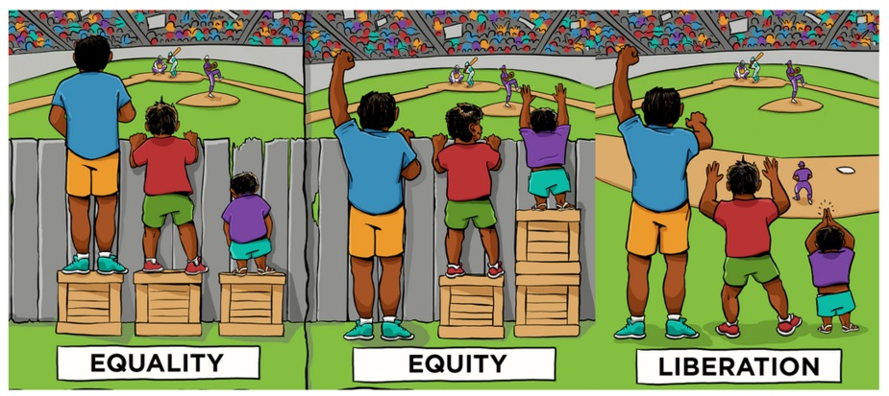
JUSTICE!

Slide 11
Q&A
Ask Us!
Notes:
Just trying to add a little humor here….does it work or should I take out the knowledge power part?

Slide 12
Talking Power & Privilege – Key Takeaways
Be vulnerable and brave enough to examine your own privilege, power and unconscious bias.
Building an internal culture that is honest and transparent about power and privilege will translate to how we show up externally with others.
Be aware that we can sometimes “make up” power dynamics, especially between different generations in families.
Pay attention to language that is steeped in power dynamics. Language matters and should lead with an asset-based mindset.

Slide 13
Talking Power & Privilege – Key Takeaways
Personally reflect on at what point do you remain conscious of your privilege…and at what points in life it is important to be conscious of it.
With awareness of privilege and power, comes the responsibility of taking action, for whether you know it or not, you do have more power and influence.

Slide 14
Talking Power & Privilege – Key Takeaways
Lack of knowledge is okay! There are going to be knowledge gaps in this line of work where you might not be able to fully understand something. There are resources out there for you to learn as much as you can though!
“Hey people with privilege, you need to be OK with making mistakes and being called out” Vu Le post, September 10, 2018

Slide 15
Talking Power & Privilege – Key Takeaways
Be comfortable with the uncomfortable. Being called out is okay, debating is healthy, and in life you may be called out, and its okay.
Notes:
Ali, please fill in your key takeaways!

