Slide 1
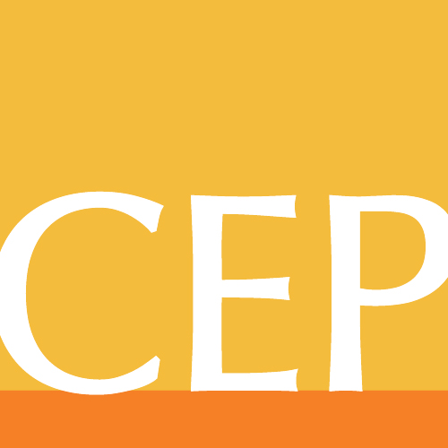
Giving Done Right:
WHAT IT TAKES
October 4, 2018
PHIL BUCHANAN
@philxbuchanan
cep.org
Notes:
Thanks so much for having me here today.
I hear it all the time. “Philanthropy is broken.” Or, as Michael Porter of Harvard Business School memorably and rather inelegantly told the Economist a decade ago, “billions a year are pissed away on ineffective philanthropy.”
What comes next, inevitably, is a call to reinvent philanthropy.
Typically, the analogy suggested is to get nonprofits to act more like business, and then to inspire givers to act like investors.
Articles that follow this basic outline are everywhere. And so are the caricatures of giving and nonprofits. Reddit cofounder Alexis Ohanian wrote this in Wired: “Let’s be real: The nonprofit model is broken. The twentieth-century way of guilting people into giving to an opaque, inefficient organization with massive overhead is no longer a viable model.”
Harvard Business School faculty like Allen Grossman have called over the years for givers to “act like venture capitalists.” I never even know quite what this means. …
Look, I like business, too.
I have an MBA, and I worked as a strategy consultant. I think business is crucial as an engine of growth, innovation, and employment. Maybe especially important in the context of this discussion, about giving, is that it is typically success in business that leads to the wealth that creates the opportunity for philanthropy.
It’s no overstatement to say that, without business, there would be no philanthropy.
And yet. Ohanian is wrong. And so is Porter. And so is Grosssman.
The calls for reinvention are generally misguided. Nonprofits are not businesses – by virtue of the simple facts that they put mission first, reinvesting their surpluses, and are so often working on the toughest challenges. Giving is not like investing – you’re not taking an ownership stake and you’re pursuing hard to measure results often in the very areas that have defied market or government solutions.
Giving done right is its own unique discipline. So what does it take to do it well?
I will concede here that at a basic and high level it sounds like exactly what it takes to succeed in business.

Slide 2
1
Choosing
GOALS
2
Finding
STRATEGIES
3
Good
IMPLEMENTATION
4
Relevant
PERFORMANCE INDICATORS
Notes:
Good choice of goals
Finding strategies to achieve those goals
Solid implementation of those strategies
Relevant performance indicators to assess progress
But the challenge is not in understanding that these elements are necessary for effectiveness, it is that they are so hard to do right in philanthropy.
Because philanthropy is different from business…. So each of these four dimensions plays out differently. My view of the essential nature of each of these for effectiveness hasn’t changed in the 17 years I have been in this job. But my understanding of how hard it is to do these things well has deepened immeasurably.
So let me talk about each of the dimensions.

Slide 3
GOALS
Notes:
Choosing goals is tough. In business, easy. Profit profit profit.
In philanthropy, it’s much tougher. How do you choose goals? Follow your heart? Use your head?
It’s subjective, after all. Values-laden.
Plus, how do you choose just one or two goals or even several, when there are so many pressing social problems, and when those problems are so interrelated?
How specific or broad they should be?
Root cause or alleviate suffering? Or both? (I’d suggest both are worthy.)
Local or international (Peter Singer’s argument). (Again, I’d suggest both have merit.)
It’s super difficult to decide. And tough to stay committed. Many take on too much, too many goals.

Slide 4
Notes:
Focus, focus, focus. Focus is crucial … but hyper-focus can have its own challenges. You need to always be open to understanding the connections across issues.
In doing research for my book, I met with a very thoughtful New York couple, Mark and Leslie Sillcox, who had focused on providing educational opportunity to low-income students. Very committed.
“We wanted to be hands-on,” Mark explained. So they mentored students, volunteering their time and developing relationships with the people their philanthropy would ultimately seek to help.
Leslie explained. “We chose our goals through a combination of analysis plus understanding.”
As they describe it, the objectives of their foundation, which makes several million dollars in grants annually, is “to contribute to the steadily growing number of young people in New York City who overcome socioeconomic barriers to graduate from public high school—and then from college—prepared for meaningful employment and robust civic participation.”
They saw good results.
But then the Sillcoxes realized that some of the students who were achieving great success academically because of the programs they supported were having all they worked for threatened because they were undocumented. They had arrived in the New York area from Latin America, often fleeing violence, and were finding that, despite their academic success, they couldn’t get financial aid for college. In some cases, they faced the risk of deportation. So, the Sillcoxes began supporting the Safe Passage Project, which provides pro bono legal counsel to undocumented minors.
They recognized that issues are interrelated. They were right not to just stay single-mindedly focused. And yet some focus is necessary because …
there are so many pressing issues.
Jay, can you add here a photo of high school students, ideally diverse, ideally in a classroom?? Tx

Slide 5
PRESSING ISSUES IN SOCIETY
65%
58%
40%
Wealth and Inequality
Climate Change and the Environment
Education
Notes:
Surveyed CEOs in 2016 – most pressing issues.
Tempting to focus on all these – and many others… But you can’t do everything well. You have to choose!
SO: Choosing goals isn’t easy. But choose you must. And then you must revisit whether your goals make sense given the context. Constant balancing act.
And then there is the question of how to make progress on them. The strategy. The how.

Slide 6
STRATEGY
Notes:
First, let me say that – broken record – strategy plays out differently in philanthropy than in business, because there are no competitive dynamics for donors. (Unfortunately, a whole slew of consultants and b-school types who tried to foist a business-based conception of strategy onto philanthropy in the late 1990s and early 2000s.)
In business, it’s all about “unique positioning.” But if I can make tremendous impact at my foundation by doing exactly what your foundation is doing, why wouldn’t I? I wouldn’t demur, by saying, “No, I don’t want to fund those vaccinations because it’s not our ‘distinctive position’ to do that work.” Focus on brand and credit – and uniqueness – can actually get in the way of effectiveness.
Let me put it this way. In business, you want your strategy to be yours alone. In philanthropy, that is a recipe for failure. Your strategy must be shared. And informed by those who know best.
So how to define strategy in philanthropy?

Slide 7
A framework for decision-making that is…
1
Focused on the external context
2
Includes a hypothesized causal connection between use of resources and goal achievement
Notes:
We at CEP define strategy as:
A framework for decision-making that is
1) focused on the external context, and
2) includes a hypothesized causal connection between use of resources and goal achievement.
But in our research, we see a disconnect between the rhetorical embrace of strategy and the reality of its actual use. This disconnect exists at both private foundations and community foundations. I think this also happens at corporate foundations and with individual givers.
Strategy in philanthropy requires a relentless focus on the logic of how you will achieve your goals. It is about data-driven decision making, rooted in analysis and a theory of how the foundation’s efforts can contribute to the desired change. Wherever possible, it’s informed by evidence of what works and what doesn’t, the more rigorous the better. It’s also influenced by feedback loops so you can constantly iterate and improve your strategy based on a changing context.
Lately, strategy has gotten a bad rap, partly because of the consultants and b-school types I just mentioned. It’s been associated with top-down, donor-driven out of touch grantmaking that rides roughshod over the perspectives of grantees and intended beneficiaries. But that’s not good strategy.
Strategy isn’t about deciding what works on high, about being arrogant or top-down. The best strategists are always questioning assumptions – theirs and others – and getting feedback.
Strategies and theories of change should be more like wikis than static documents.
Not easy …. Especially when you choose to work on some of the toughest issues, as you have ….
But it can be done. And when it is done right, great results.
Good philanthropic strategy has contributed to a lot of progress. ….

Slide 8
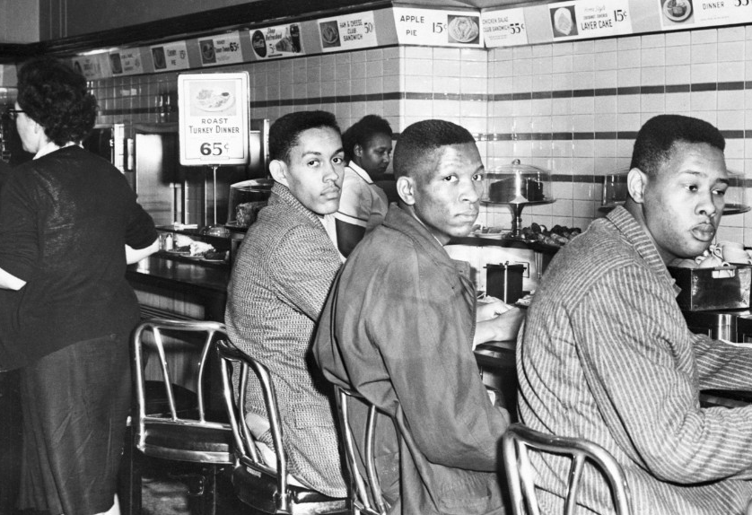
Photo credit: CNN
Notes:
Our 911 emergency response system
Better treatment of diseases – such as diabetes
Improved outcomes for foster kids
Progress on childhood obseity
Civil rights for LGBT people
For African-Americans
These strategies were thought out, logical – connection between goal and resource allocation always in mind. They also were iterated based on learning. Not static.
In general: they were shared …. Not the strategies of a single actor!

Slide 9
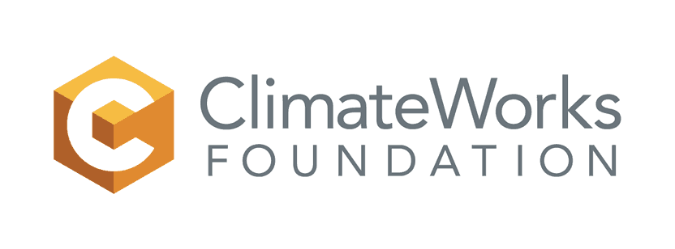
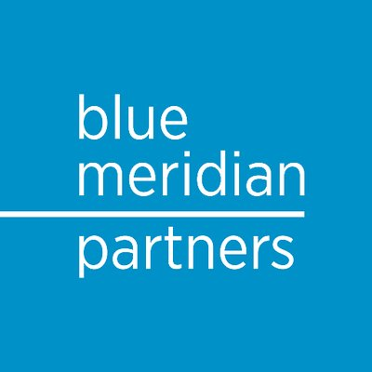
Notes:
Strategy needs to be shared or it will generally fail, especially when dealing with the most daunting challenges…
Giving circles popularity. Big funders re-discovering need for collaboration. High profile efforts like these of donors to come together.

Slide 10
Notes:
Strategy matters.
But there is lots of bad strategy – and bad implementation of strategy….

Slide 11
IMPLEMENTATION
OF STRATEGY
Notes:
A lot of it breaks down then givers don’t realize that it doesn’t matter how smart their strategy sounds if others don’t think so too.

Slide 12
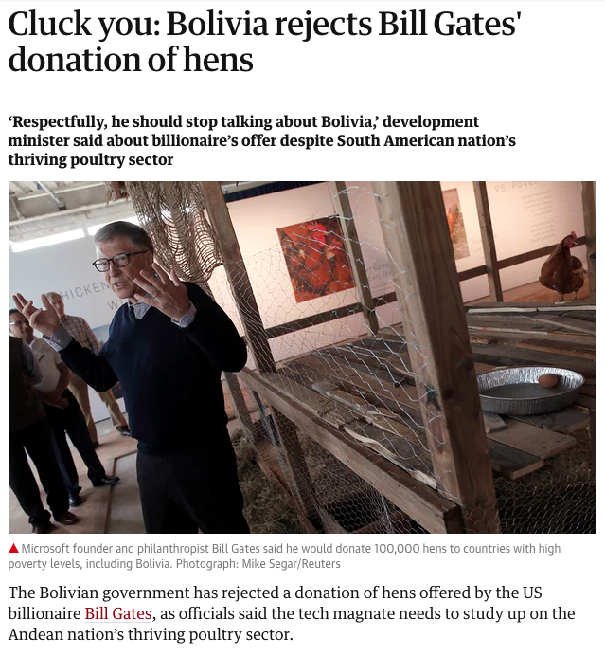
Notes:
Bill Gates and chickens. In 2016, the biggest givers of them all, Bill & Melinda Gates, decided to donate 100,000 hens in developing countries, in partnership with the nonprofit Heifer International, to combat extreme poverty. Bill Gates had written a blog post about the wisdom of raising chickens as a way out of poverty.
“It’s pretty clear to me that just about anyone who’s living in extreme poverty is better off if they have chickens. In fact, if I were in their shoes, that’s what I would do—I would raise chickens,” he wrote. In the post, he announced a new effort to give hens to developing countries. “Our foundation is betting on chickens.”
But, while the wisdom of this effort may have been clear to Gates, it wasn’t necessarily clear to everyone else. In fact, the Bolivian government rejected the help, calling it “offensive.”
Headline “Cluck You.”
“He does not know Bolivia’s reality to think we are living 500 years ago, in the middle of the jungle not knowing how to produce,” said César Cocarico, the country’s minister of land and rural development. “Respectfully, he should stop talking about Bolivia, and once he knows more, apologise to us.”
Givers sometimes feel like they know what’s best for those they intend to help. It’s perfectly clear to them. They’ve got just the thing to address the problem. Sometimes, they’re right. Sometimes, they’re wrong. Let’s assume that, in Bill Gates’ case, raising chickens is indeed the best thing someone living in extreme poverty can do. The problem is this: it doesn’t really matter if Gates is right if the poor people (or those who stand between the donation and the people) he intends to help don’t think so. Or if they are insulted by the suggestion.
Effective givers understand how important it is to listen to and learn from those on the ground.

Slide 13
PROMISING PRACTICES
69%
Learning from the experiences of those they ^{are ultimately trying to help}
67%
Learning from the knowledge or experiences ^{of grantees}
64%
^{Taking more risk}
59%
^{Collaborating with one another}
^{Simultaneously} collaborating with foundations, business, government, and nonprofits
Notes:
We asked foundation CEOs in 2016 about 24 specific practices that would unleash greater impact? Wanted CEOs to tell us about how much promise they hold for increasing foundation impact ….
Also asked about specific practices. Impact investing. Scaling programs that work. The hot topics. 24 of them. Ones I just mentioned were not the ones seen as having the most promise for increasing foundation impact. ….
Much greater than impact investing for example. ….
Learn from those you seek to help.
Learn from grantees …. Grantee surveys. Tens of thousands.

Slide 14
Some funders seem to come into the relationship thinking that they know more than we do.
Funders do probably spend more time reading academic literature, but they don’t spend time with low-income people. While they have much to teach us, we also have much to teach them.
The best funders realize that.
Notes:
Bryan Stevenson notes that “we have too many people trying to problem-solve from a distance.”

Slide 15
The more you hurt, the more you help.
JASON HACKMANN
Notes:
Let me tell you the story of an individual giver who tried to close that distance. Someone else I met while working on my book.
Jason Hackmann comes from the small, rural town of Winfield, Missouri. He describes his childhood as ordinary, growing up in a lower-middle-class family. He graduated from his small high school—his graduating class had just 65 students—in the spring of 1995.
That’s also when his brother was killed by a drunk driver.
The crushing loss of his brother fueled Hackmann’s ambition to be successful and to break free of the small-town life he’d grown up living. He built a successful career, eventually founding a life insurance company in St. Louis that caters to extremely wealthy clients. After his first child was born, in 2004, Hackmann began thinking about what really mattered to him. For him, like so many donors, his religious beliefs were a big part of this. His past giving, he confessed, had been made with “ulterior motives” related to his business interests.
It was on a family vacation in Turks and Caicos in 2008 that his perspective really changed. He read about child slavery in Ghana and decided he needed to do something. For him, it was connected to his loss of his brother.
“If my brother hadn’t died, and I hadn’t felt that pain, I wouldn’t have opened myself up to this work,” he told me.
A year later, Hackmann found himself taking vacation time again. But this time he was in Ghana with Jennifer and their three children, the oldest of whom was five. “Our friends thought we were crazy,” he said. Getting involved in this way changed Hackmann. “For the first time in my life, I wanted to do something, and I wanted nothing in return. I just wanted to help another human being,” he explained.
Hackmann would be in Ghana more than a dozen times over the next three years, seeking to understand how to help do something about the fact that children as young as three or four were being sold as slaves to Ghanaian fishermen. He spent time with—and gave money to—small, local nonprofits working to help affected children and spoke with many of those children himself.
He could not get out of his head the six-year-old he had met who was a slave to a fisherman. Hackmann described the boy’s withdrawn, remote demeanor: “He had no smile.” The organization Hackmann was working with sent him a photo a year later of the same boy, now freed, smiling broadly. “I realized, ‘Holy shit. Giving is better than receiving.’ My mom always told me that, but I never believed it.”
Over time, Hackmann contributed more than $1 million to a large Christian nonprofit, the International Justice Mission, helping to persuade its leaders to seek to end childhood slavery in Ghana, which he believes is achievable by 2022 or 2023. Hackmann has devoted much of his energy to this and related efforts, even launching a new product offering from his company and dedicating all the profits to the cause.
“The more you hurt, the more you help,” Hackmann told me. Getting close to a problem as searing and unfathomable as childhood slavery is emotionally taxing. But it also inspired Hackmann to do work that has given a new level of meaning to his life.
Like for many Americans, Hackmann’s giving has been motivated by his religious beliefs, which have inspired him to get close to suffering and to try to do something about it. Others’ motivations come from different sources. But whatever impels givers to get close to those they seek to help and to open themselves up to the suffering of others, the result is better-informed and more effective giving.
It’s about building understanding. Of the people you seek to help. But also of the grantee organizations on the ground. That’s what we see in our research. Understanding is a key to strong relationships between givers and nonprofits. And those relationships are essential for effectiveness and impact.

Slide 16
KEYS TO FORMING A STRONG FUNDER-GRANTEE RELATIONSHIP
Notes:
Our statistical analysis of what best predicts the strength of a funder-grantee relationship resulted in 5 keys.
The two most important keys to forming strong relationships are the funder developing a deep enough understanding of grantee organizations and the context in which they work – and – being transparent.
Those are, by far, the two strongest keys that emerged from our analysis.
Then, less strong but still important are:
how helpful grantees find the selection process to be in strengthening the project or program funded;
how open they experience the foundation being to ideas about it strategies;
and how much pressure they felt to modify their priorities in order to receive funding
You also have crucial choices to make in terms of what kind of support you provide to your grantees. While there is a time for project support, we know from our research how important unrestricted support is to nonprofits. And you need strong organizations whose goals overlap with yours to be successful.
And yet. Remains too rare.
It’s hard to get good data but what is available – from Foundation Center – shows no progress on this front.

Slide 17
Distribution of Grants by Support Strategy, 2004-2014 – Foundation Center

Slide 18
95%
of foundation leaders believe their foundation cares about strengthening the overall health of grantee organizations.
Half
of nonprofit CEOs report that their foundation funders feel no, or just a little, responsibility for strengthening grantee organizations.
Notes:
95 percent of foundation leaders believe their foundation cares about strengthening overall health of grantee organizations.
Half of nonprofit CEOs report their foundations feel no, or just a little, responsibility for strengthening grantee organizations.
Implementation not just about foundation-grantee relationship. But it’s a crucial component.
To understand how well strategy is being implemented, as well as what results you’re achieving, you need to assess ….

Slide 19
INDICATORS TO
ASSESS
Notes:
This, too, is not a new concept – the earliest major American philanthropists, the men behind the first mega-foundations, cared deeply about assessment. …
It’s very difficult! No analog to ROI. No simple metric.
But, still, there has been progress on this front in the past decade. We see in our research that CEOs see assessment of foundation performance as a high priority. They believe much progress has been made in the last decade but that more needs to be done.
This is good news. But there is more to be done.
Foundation leaders and grantees both want foundations to do more to share information about what hasn’t worked – so we don’t repeat each other’s mistakes.
To do this we need to know what works. Too often we don’t. Well-worn examples…

Slide 20
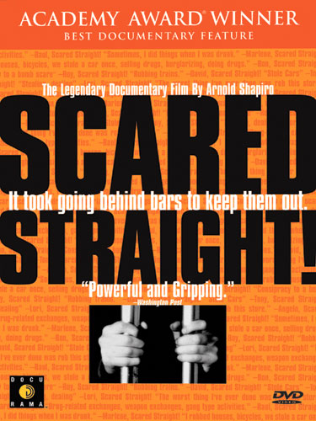
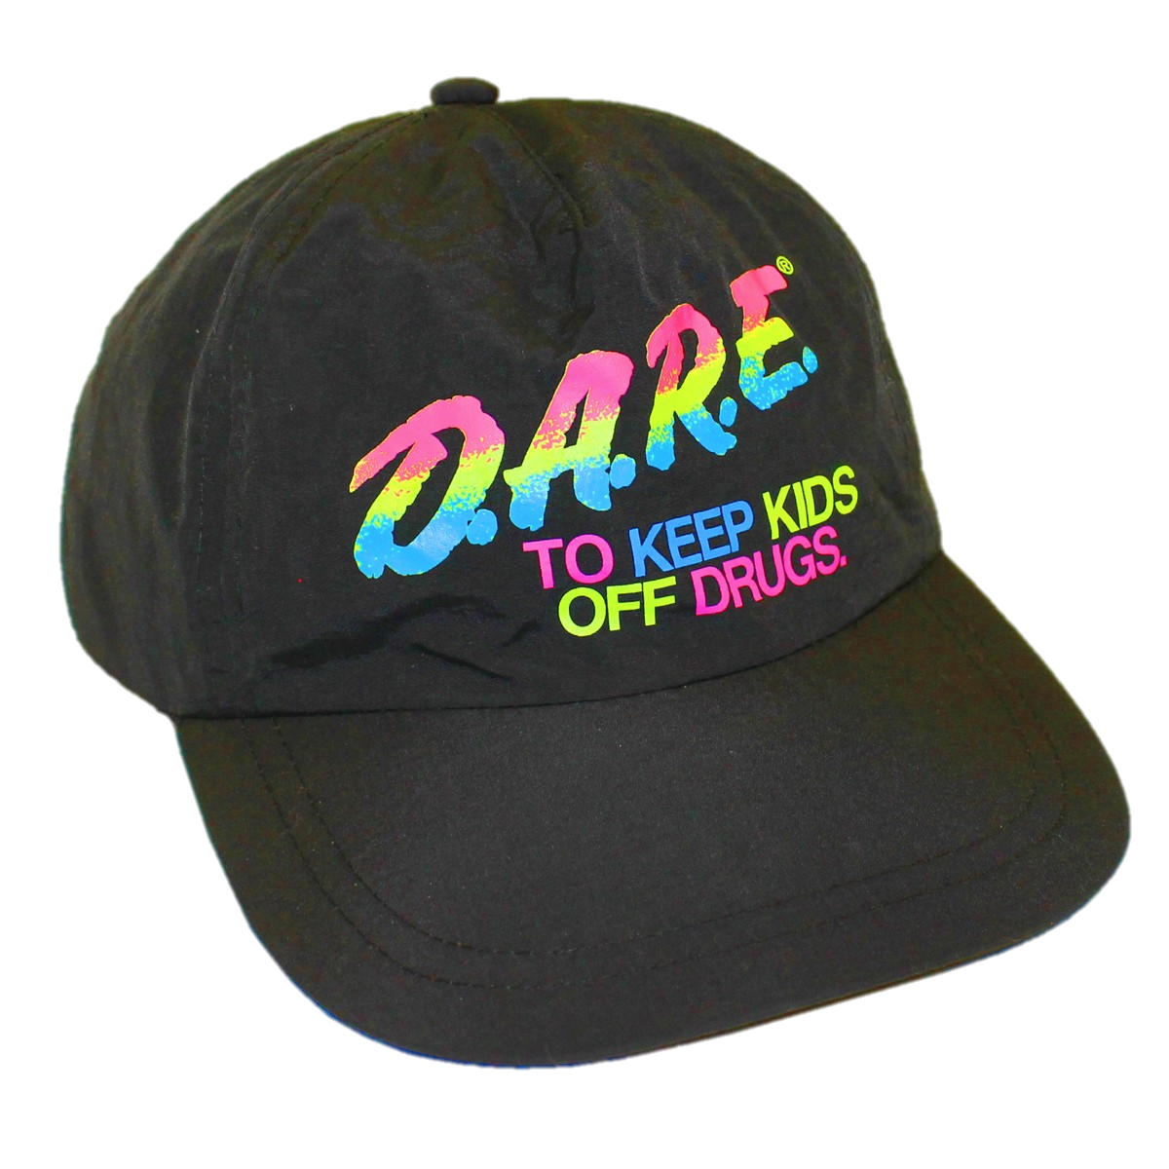
Notes:
It’s incredible really. In a 2012 meta-evaluation of Scared Straight, the evaluators write:
“Evidence indicates that there is a greater probability than not that it will be harmful. Would you permit a doctor to use a medical treatment on your child with a similar track record of results?”
What are today’s examples?
Need to learn what does and doesn’t work – and then share it.
More new CEP research….

Slide 21
19%
of CEOs say they have quite a bit of knowledge about what is working in programmatic efforts of other foundations working on the same or similar goals.
6%
say they have quite a bit of knowledge about what is not working in programmatic efforts of other foundations working on the same or similar goals.
Notes:
Only 19% of foundation CEOs say they have quite a bit of knowledge re what is working in the programmatic efforts of other foundations working on the same or similar goals.
Just 6% say they have quite a bit of knowledge re what is not working in the programmatic efforts of other foundations working on the same or similar goals.
Funders often ask a lot of nonprofits when it comes to assessment. But nonprofits need support. And, generally, they’re not getting what they need.

Slide 22
THREE QUARTERS
of foundations indicate supporting nonprofit efforts to assess their performance
TWO THIRDS
of nonprofits say they don’t receive support for their assessment efforts
Notes:
Performance assessment a challenge…

Slide 23
Notes:
You can start by getting feedback. Burst the bubble of positivity in which funders inevitable reside with candid and comparative feedback. Big part of what CEP does.
You can also be transparent about what you learn. In the survey we just fielded on assessment, we saw that only 39 percent of CEOs say their foundation shares what it has learned about what is and is not working with other foundations working toward the same goals very often or always!
We need to know.

Slide 24
1
Choosing
GOALS
2
Finding
STRATEGIES
3
Good
IMPLEMENTATION
4
Relevant
PERFORMANCE INDICATORS
Notes:
Good choice of goals
Finding strategies to achieve those goals
Solid implementation of those strategies
Relevant performance indicators to assess progress

Slide 25
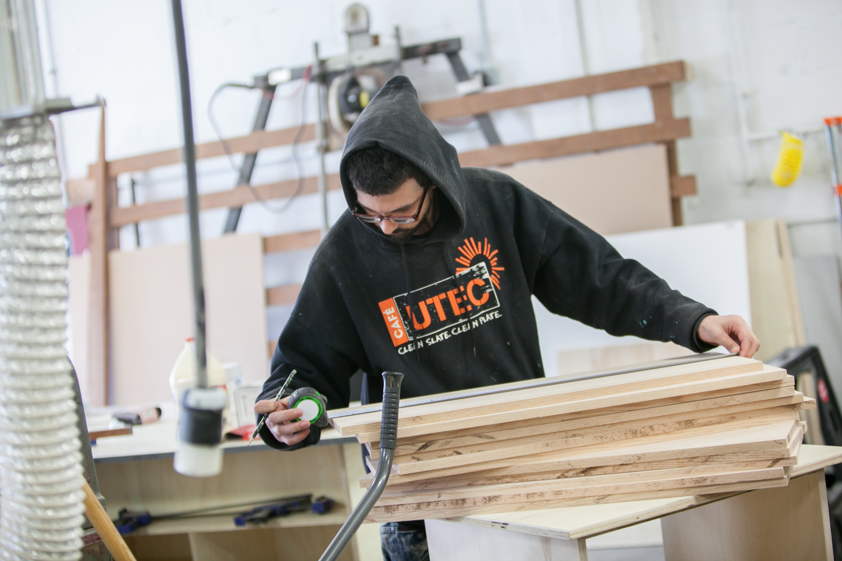
Notes:
Underneath all this is humility … and a respect for the distinct role of the nonprofit sector and the incredible and unique challenge of running a nonprofit.
Close with a story of one that I write about in my book.
Gregg Croteau, who is here at this conference today, runs UTEC, a nonprofit in the old mill town of Lowell, Massachusetts, a small city 30 miles northwest of Boston with a population of 108,000.
Croteau was the founding executive director of UTEC, which was formed by a group of teen leaders in 1999 in response to rampant gang violence. He was hired in 2000, when a $40,000 grant from the city was secured to get the organization off the ground. He responded to a small ad in the help wanted section of the local newspaper that read, “EXCITING OPPORTUNITY. Teen Center needs Executive Director to create structure, dev. capacity, win sustaining funds, coordinate programs.”
Croteau knew this was the job for him. In the early days at UTEC, he was learning on the job. “A good day was breaking up a fight,” he recalled.
Today, UTEC, which aims to “nurture the ambition of proven-risk youth to trade violence and poverty for social and economic success” in Lowell and the neighboring cities of Lawrence and Haverhill, is literally saving lives. UTEC has been held up as a model by both the current and former governors of Massachusetts and is nationally recognized for its results. It has a staff of 45 and a budget of more than $6 million as it seeks to reach the members of the more than 40 active gang sets operating in the region, as well as those young adults currently incarcerated. UTEC serves 800 to 900 young people each year, working intensively with about 160 to get them out of criminal activity and into a productive job.
Any given day finds Croteau and UTEC’s “street workers” at a bedside in a hospital after a shooting or visiting a gang member in prison or attending a funeral. These are the places where UTEC staff find they can best begin the process of recruiting a young person to leave street life behind.
Alternatively, you might find Croteau working with staff who help UTEC’s participants study for their GED. Or you might find him at one of UTEC’s several social enterprises—including a mattress-recycling facility, a catering outfit, a café, and a woodworking shop that sells its cutting boards to Whole Foods—that bring in a million dollars in annual revenues and give its clients their first foothold in the working world. Or you might find him negotiating to secure a contract to supply almond and honey nut butter to grocery stores in the Northeast through UTEC’s new commercial kitchen, which will employ another 16 former gang members. Or you might find him raising money from business leaders or foundations. Or you might find him meeting with legislators to convince them to reform our criminal justice system.
Or you might find him on the phone with city leaders, trying to identify a new, larger facility for UTEC’s mattress-recycling operation, as he was one day when I visited with him in late 2017.
Croteau is an educator, mentor, counselor, spiritual advisor, manager, businessman, fundraiser, policy advocate, mediator, and peacemaker all wrapped up into one. His job is infinitely more complicated and difficult than running an equivalent-size business—and yet his salary is just a fraction of what he could make elsewhere. He is passionate about what he does and totally focused on results—judging success by an array of metrics that include declining numbers of shootings and arrests. The overwhelming majority of young people who enter UTEC’s programs stay out of jail and remain employed. UTEC’s recidivism rate (those getting rearraigned after returning from incarceration within one year) is 10 percent, compared to the state average of more than 50 percent.
Although Croteau has won the support of some major foundations, he spends much more time than he’d like raising money—and too much of the agency’s support comes in restricted grants that deny him the flexibility to allocate resources where he thinks they’ll do the most good or to pay the salaries he believes his staff deserve. “Project funding seems great, but you’re expanding your projects without expanding the engine of the organization,” he explained.
Croteau works nonstop—he’s not home until 9 p.m. most nights and bought himself a treadmill desk so he could get a bit of a workout in during meetings in his office. Then he bought an exercise bike for those he’s meeting with so they can exercise, too. He’s quick to emphasize that he used his money, not UTEC’s, for these indulgences—lest anyone think he isn’t a good steward of philanthropic resources.
He told me he has never given thought to doing anything other than what he does, working with the highest-risk young adults. His passion is contagious. “We can’t let this violence ever be seen as normal,” he told a group of new UTEC employees at an orientation session I visited. “Because it’s not. It’s not normal.”
The people leading nonprofits like UTEC and literally hundreds of thousands of others are talented individuals and leaders, grappling with a unique set of challenges. Understanding and respecting how difficult their roles are is crucial to being an effective giver. To spend time with talented nonprofit leaders is to be reminded that it is people like them who make our country better. They never give up on anyone and employ the best methods to help them.
They are unsung American heroes.
Givers do best when they recognize, respect, and get behind leaders whose goals overlap with their own and who are delivering results—leaders of organizations like these.
Givers do best when they generously support leaders and organizations whose goals and strategies align with theirs, empowering them to help strengthen our society and improve lives.
Giving done right isn’t easy.
But it’s all around us even as we can all agree we need more, much, much more, of it.
Jay can you animate so this photo comes in?

Slide 26
Thank You.
PHIL BUCHANAN
@philxbuchanan
cep.org
Notes:
Thank you.

